Slide 1
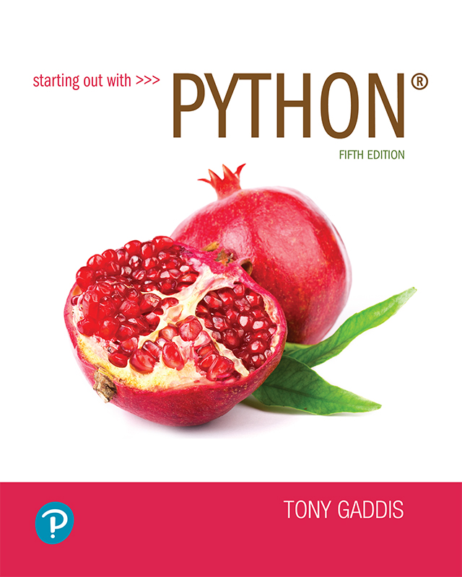
Starting out with Python
Fifth Edition
Chapter 1
Introduction to Computers and Programming
Copyright © 2021, 2018, 2015 Pearson Education, Inc. All Rights Reserved

Slide 2
Topics
Introduction
Hardware and Software
How Computers Store Data
How a Program Works
Using Python

Slide 3
Introduction
Computers can be programmed
Designed to do any job that a program tells them to
Program: set of instructions that a computer follows to perform a task
Commonly referred to as Software
Programmer: person who can design, create, and test computer programs
Also known as software developer

Slide 4
Hardware and Software
Hardware: The physical devices that make up a computer
Computer is a system composed of several components that all work together
Typical major components:
Central processing unit
Main memory
Secondary storage devices
Input and output devices

Slide 5
The CPU
Central processing unit (CPU): the part of the computer that actually runs programs
Most important component
Without it, cannot run software
Used to be a huge device
Microprocessors: CPUs located on small chips

Slide 6
Main Memory
Main memory: where computer stores a program while program is running, and data used by the program
Known as Random Access Memory or RAM
CPU is able to quickly access data in RAM
Volatile memory used for temporary storage while program is running
Contents are erased when computer is off

Slide 7
Secondary Storage Devices
Secondary storage: can hold data for long periods of time
Programs normally stored here and loaded to main memory when needed
Types of secondary memory
Disk drive: magnetically encodes data onto a spinning circular disk
Solid state drive: faster than disk drive, no moving parts, stores data in solid state memory
Flash memory: portable, no physical disk

Slide 8
Input Devices
Input: data the computer collects from people and other devices
Input device: component that collects the data
Examples: keyboard, mouse, touchscreen, scanner, camera
Disk drives can be considered input devices because they load programs into the main memory

Slide 9
Output Devices
Output: data produced by the computer for other people or devices
Can be text, image, audio, or bit stream
Output device: formats and presents output
Examples: video display, printer
Disk drives and USB drives can be considered output devices because data is sent to them to be saved

Slide 10
Software (1 of 2)
Everything the computer does is controlled by software
General categories:
Application software
System software
Application software: programs that make computer useful for every day tasks
Examples: word processing, email, games, and Web browsers

Slide 11
Software (2 of 2)
System software: programs that control and manage basic operations of a computer
Operating system: controls operations of hardware components
Utility Program: performs specific task to enhance computer operation or safeguard data
Software development tools: used to create, modify, and test software programs

Slide 12
How Computers Store Data
All data in a computer is stored in sequences of 0s and 1s
Byte: just enough memory to store letter or small number
Divided into eight bits
Bit: electrical component that can hold positive or negative charge, like on/off switch
The on/off pattern of bits in a byte represents data stored in the byte

Slide 13
Storing Numbers
Bit represents two values, 0 and 1
Computers use binary numbering system
Position of digit j is assigned the value 2^{j-1}
To determine value of binary number sum position values of the 1s
Byte size limits are 0 and 255
0 = all bits off; 255 = all bits on
To store larger number, use several bytes

Slide 14
Storing Characters
Data stored in computer must be stored as binary number
Characters are converted to numeric code, numeric code stored in memory
Most important coding scheme is ASCII
ASCII is limited: defines codes for only 128 characters
Unicode coding scheme becoming standard
Compatible with ASCII
Can represent characters for other languages

Slide 15
Advanced Number Storage
To store negative numbers and real numbers, computers use binary numbering and encoding schemes
Negative numbers encoded using two’s complement
Real numbers encoded using floating-point notation

Slide 16
Other Types of Data
Digital: describes any device that stores data as binary numbers
Digital images are composed of pixels
To store images, each pixel is converted to a binary number representing the pixel’s color
Digital music is composed of sections called samples
To store music, each sample is converted to a binary number

Slide 17
How a Program Works (1 of 3)
CPU designed to perform simple operations on pieces of data
Examples: reading data, adding, subtracting, multiplying, and dividing numbers
Understands instructions written in machine language and included in its instruction set
Each brand of CPU has its own instruction set
To carry out meaningful calculation, CPU must perform many operations

Slide 18
How a Program Works (2 of 3)
Program must be copied from secondary memory to RAM each time CPU executes it
CPU executes program in cycle:
Fetch: read the next instruction from memory into CPU
Decode: CPU decodes fetched instruction to determine which operation to perform
Execute: perform the operation

Slide 19
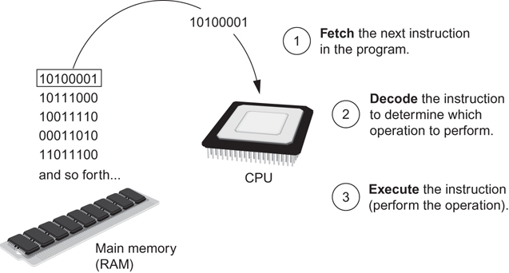
How a Program Works (3 of 3)
Figure 1-16 The fetch-decode-execute cycle

Slide 20
From Machine Language to Assembly Language
Impractical for people to write in machine language
Assembly language: uses short words (mnemonics) for instructions instead of binary numbers
Easier for programmers to work with
Assembler: translates assembly language to machine language for execution by CPU

Slide 21
High-Level Languages
Low-level language: close in nature to machine language
Example: assembly language
High-Level language: allows simple creation of powerful and complex programs
No need to know how CPU works or write large number of instructions
More intuitive to understand

Slide 22
Keywords, Operators, and Syntax: an Overview
Keywords: predefined words used to write program in high-level language
Each keyword has specific meaning
Operators: perform operations on data
Example: math operators to perform arithmetic
Syntax: set of rules to be followed when writing program
Statement: individual instruction used in high-level language

Slide 23
Compilers and Interpreters (1 of 3)
Programs written in high-level languages must be translated into machine language to be executed
Compiler: translates high-level language program into separate machine language program
Machine language program can be executed at any time

Slide 24
Compilers and Interpreters (2 of 3)
Interpreter: translates and executes instructions in high-level language program
Used by Python language
Interprets one instruction at a time
No separate machine language program
Source code: statements written by programmer
Syntax error: prevents code from being translated

Slide 25
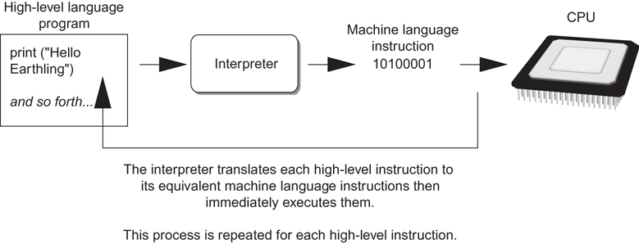
Compilers and Interpreters (3 of 3)
Figure 1-19 Executing a high-level program with an interpreter

Slide 26
Using Python
Python must be installed and configured prior to use
One of the items installed is the Python interpreter
Python interpreter can be used in two modes:
Interactive mode: enter statements on keyboard
Script mode: save statements in Python script

Slide 27
Interactive Mode
When you start Python in interactive mode, you will see a prompt
Indicates the interpreter is waiting for a Python statement to be typed
Prompt reappears after previous statement is executed
Error message displayed If you incorrectly type a statement
Good way to learn new parts of Python

Slide 28
Writing Python Programs and Running Them in Script Mode
Statements entered in interactive mode are not saved as a program
To have a program use script mode
Save a set of Python statements in a file
The filename should have the .py extension
To run the file, or script, type
python filename
at the operating system command line

Slide 29
The IDLE Programming Environment
IDLE (Integrated Development Program): single program that provides tools to write, execute and test a program
Automatically installed when Python language is installed
Runs in interactive mode
Has built-in text editor with features designed to help write Python programs

Slide 30
Summary
This chapter covered:
Main hardware components of the computer
Types of software
How data is stored in a computer
Basic CPU operations and machine language
Fetch-decode-execute cycle
Complex languages and their translation to machine code
Installing Python and the Python interpreter modes

